Slide 1
Sea Bass (4b,-c,7a,7d-h) : Assessment and Advice
Presentation prepared by Alain Biseau (French ICES-ACOM member)

Slide 2
Data used
Commercial Landings (since 1985).
Commercial Discards (since 2009 (FR) and 2002 (UK)
Age and Length frequencies (from catch sampling)
Recreational Removals in 2012 (France, Netherland, and UK) [1440 t =1410 ‘landed’ + 30 dead after release]
Recruit Survey (UK Solent, since 1986 (excl 1988, 2004, 2010 and 2012) )
Bottom Trawl Survey (FR CGFS, 1988-2014)
Commercial CPUE (French fishery, since 2001)
Growth and Maturity (from sampling of commercial catches and surveys)
Natural mortality (inferred from life history parameters (longevity, growth and maturity) and maximum observed ages) [= 0.24, fixed over ages and years]

Slide 3
Assumptions
Recreational Removals series:
Fishing mortality (F_{rec}) for recreational activities is for Removals :
dead catches = fish kept + fish dead after release (estimated to be 5%).
F_{rec} kept constant (Note F, not the catches) during 1985-2014 = 0.604
[obtained by iterations such as Recreational removals in 2012 = 1440 t]
Since 2015, an F multiplier was applied to the Fs to take account of the corresponding management measures:

Slide 4
Assumptions
Recreational Removals series:
Minimum size
Before July 2015 : 36 cm
Since July 2015 : 42 cm
Bag limit :
Before 2015 : none
2015 : 3 fish / fisherman/day – 6 months
2016-2017 : 1 fish / fisherman/day – 6 months
2018 : 1 fish / fisherman/day – 3 months
2019 : 1 fish / fisherman/day – 7 months

Slide 5
Assumptions
Recreational Removals series:
Fishing mortality
Before 2015 : 0.0604
2015 : 0.0503
2016 : 0.0170
2017 : 0.0170
2018 : 0.0093
2019 : 0.0188

Slide 6
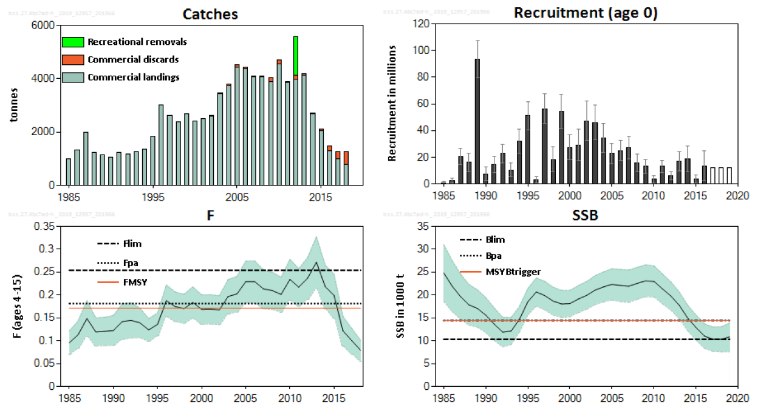
Assessment
F₂₀₁₈ < F_{MSY} BUT SSB closed to B_{lim}

Slide 7
Assessment

Slide 8
Forecast / Advice
Following the Inter-benchmark (correction of an error in the CPUE series, changing mainly the values over the period 2001-2008), revision of F and B estimates, implying the revision of the reference points:
MSY Btrigger : from 13465 to 14439 t FMSY from 0.203 to 0.1713
➔ revision of the advice provided in 2018 for 2019 (using the output of this year assessment)

Slide 9
Advice
Revised advice for 2019 (Fishing at F=F_{MSY} reduced by SSB₂₀₁₉/MSY-B_{trigger}) : from 1789 tonnes to 1806 t
Advice for 2020 (Applying the MAP: withing the range F_{MSY lower} reduced and F_{MSY} reduced): between 1634 and 1946 tonnes
[no F_{MSY upper} defined for that stock. Even if, should not be considered according to the MAP since current SSB is below MSY-B_{trigger})

Slide 10
Advice
NOTE that the advice is for ‘Total removals’ (commercial catches and recreational removals)
ICES does not advice for any particular share between commercial and recreational activities.
The ‘option table’ in the advice sheet provides the value of both components IF the current share/management continues. This is only for illustration purposes.

Slide 11
Thank you !

