Slide 1
Sea Bass 2015 and 2016
Package approach to reducing Mortality on sea bass stock in Celtic Sea, Irish Sea, Channel and southern North Sea.
Aim of reducing proportionally impact from all sources of mortality.
Actions based on 2015 advice.
2016 advice – revised approach

Slide 2
Package Proposed
Pelagic closure
Feb-April
Recreational limits
Annual
Commercial Fisheries
Catch Limits
Prohibited area
MLS / MCRS Increase

Slide 3
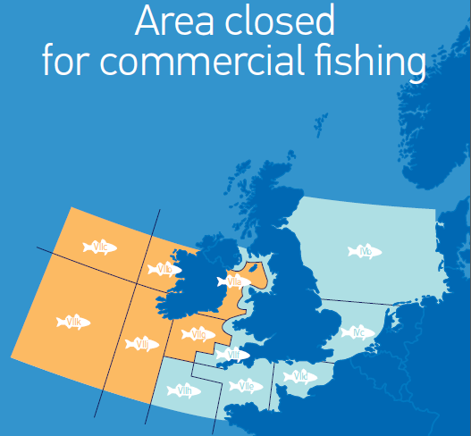
Notes:
1a What is the position with the existing measures?
The emergency measures close on the 30th April, they will not be renewed. The three fish limit on recreational fishermen will remain in place in 2015, it is linked to an annual regulation (so can be varied by council each year).
1b Any evidence of impact of these measures (positive and negative) would be welcomed but I appreciate that it is very early days since introduction.
We have catches submitted by the Member States however one MS data has not been fully updated and we are working to address what I understand to be a technical issue rather than a reporting one. I will forward these catches as soon as I have them complete. However it seems that there is an overall decrease in catches, as would be expected under the closure, but we need to fully examine this for each of the gears, STECF will be asked to under take this in time for thier July Plenary.
2. A list of proposed further measures. If this is available I would propose that we present them to the seminar participants and they have the opportunity to discuss the practicalities of implementing and the potential impact it would have to them.
There are two pieces of legislation under development
a A second amendment of the TAC and quota Reg, proposed on the 20th May proposes to extend the current Irish prohibition on commerical fisheries to other Member State vesselsm in waters adjacent to Ireland (ICES divisions VIIb, VIIc, VIIj and VIIk. as well as ICES divisions VIIa and VIIg, except the waters within 12 nautical miles from baseline under the soverignity of the United Kingdom. This amendment also proposed catch limits for various gears. The proposed figures are below but these remain to be discussed at Council working party- on the 29th May.
Gear type
Maximum catch of sea bass permitted per vessel per calendar month (in kg)
OTM or PTM, Mid water or pelagic trawls
1 500
OTB, all types of demersal trawls including Danish / Scottish seines
1 500
All GN, all drift net and fixed (trammel) net fisheries
1 000
All LL, all long lines or pole and line fisheries
1 000
purse seines
3 000
b Further we propose to increase the MLS under the technical conservation Measures Regulation (EC 850/98). This proposal is made under the process provided in the TCM regulation. This means the propsal is discussed by the examination Committee and this will begin on the 5th June.
3. Any timescales we should be aware of. We recognise that we are too late to influence decision making in 2015 but it takes time to develop AC advice.
I agree there is limited time for the advisory committees to influence the measures we have proposed for 2015. It is still possible to influence the MS , who ultimately decide on these proposals
A response on the impact of the prohibition, catch limits by metier and of course the change on MLS would all be required. Please note that the Council will have thier first discussion on this on the 29th May. I expect that it will be difficult to develop a concensus on all these points. The ability of individual fishermen to adapt to a new MLS and catch limits will vary enormously.
Leaving aside he current proposals ( whcih are in response to last years advice) there are two key points AC need to consider- advice for the december council on 2016 measures and input into Multiannual planning (by September)
I would encourage the AC however to use this discussion and the proposals as the basis for measures for 2016. The stock dynamics are unlikely to change greatly and we need to develop a mechanism to ensure that we can avoid a repeat of emergency measures-allowing for a more proactive approach,
I would suggest that measures for 2016 are a point for the agenda and that definate timelines are set to try and provide timely advice before the christmas council meeting.
The July 2014 STECF Plenary highlighted some points on the various options. However if you wish to develop techncial solutions, closed areas, etc then the time is again very challanging.
These need to be part of a regional / industry proposed managment plan. The development schedule of this needs to be agreed. Social and economic impacts will need to be addressed.
Longer term we will seek to include sea bass in a multi annual plan. It remains to be determined during the scoping/ development of the NWW plan if sea bass is part of a multi species plan or a single species. We will be seeking AC input into the scoping/objectives of the plan before September. A formal request should be issued shortly on this. there will be later opportunity to provide more advice on specific measures in 2016.
My line manager may have further points.
Hope this is helpful.
Robert Griffin
PS

Slide 4
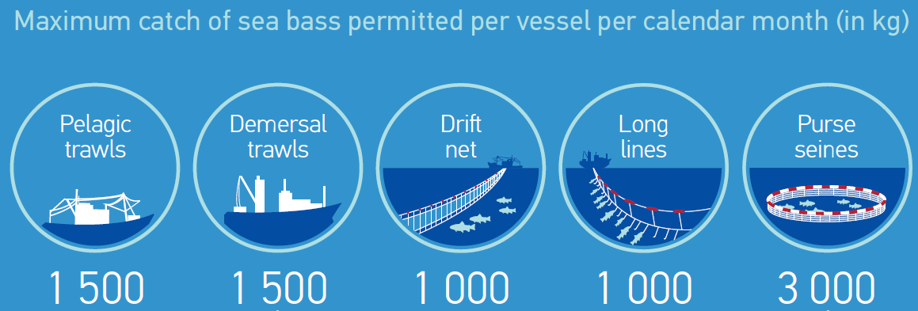
Catch Limits
Non transferable,
lowest catch level of gear used

Slide 5
Time Lines
2nd Amendment. 28th May Council
MLC / MCRS Executive Committee discussion 5th June.
ICES Advice: End of June
STECF Advice July (provisional)
December Council: Catch limits and 2016.

