Slide 1
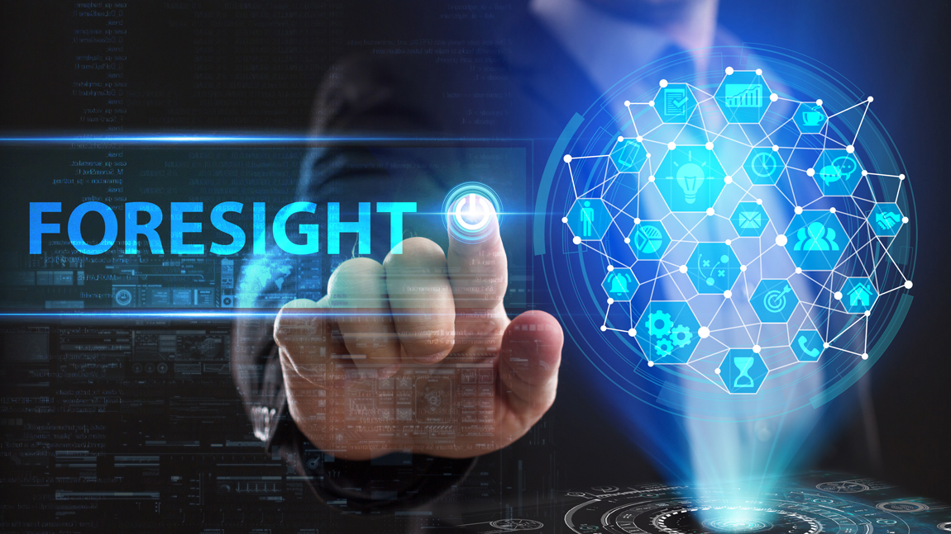
STRATEGIC FORESIGHT by Stephen Davies, DG MARE, European Commission
Inter-ACs meeting
17 November 2022
Image Source: ©Photon photo/Shutterstock

Slide 2
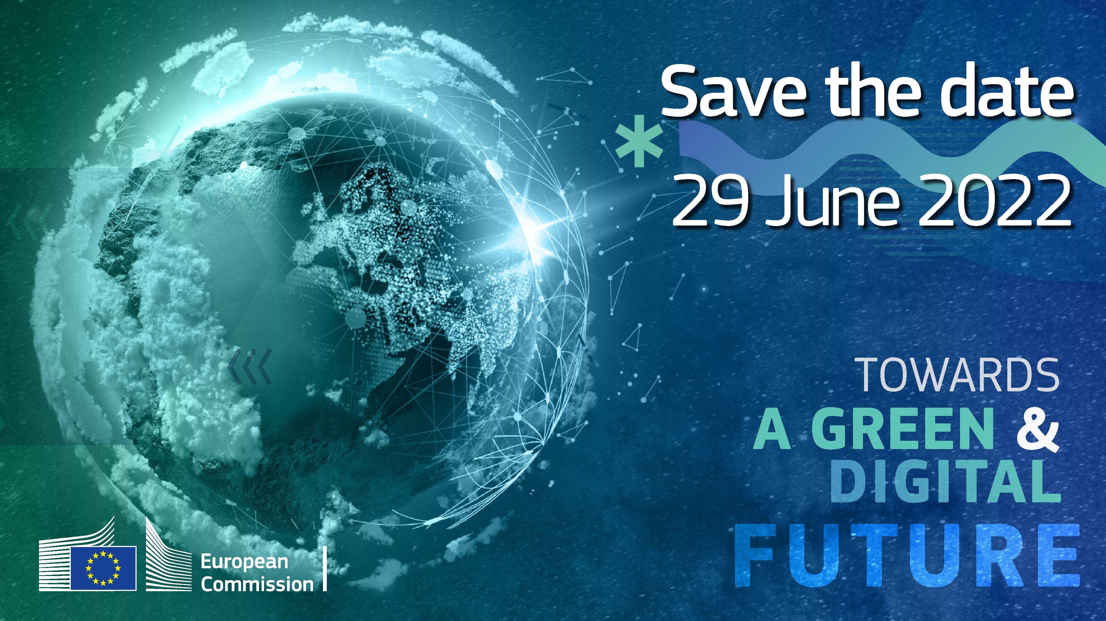
What is Strategic Foresight?
“Foresight helps you think more deeply about potential futures. When you think more expansively about these futures, you are able to make more strategic decisions in the present.”
Amanda Reeves, Foresight expert, @WabiSabiFutures
What if….?

Slide 3
How?
Horizon scanning: a systematic scan and collection of events and trends, the output being a future-scape or visual mapping of new signals of change.
Megatrends analysis: analysis and discussion of pattern shifts and interacting trends, the output being a story of the future (singular) and a plan of action.
Scenario planning: interactive and iterative process, involving interviews, analysis and modelling, the output being a set of stories of plausible futures, whether we like them or not, and how these might come about.
Visioning: identification of a preferred direction, the output being a shared understanding and explicit description of the preferred future and a medium-term roadmap detailing specific actions for making progress towards the vision.

Slide 4
Strategic Foresight in EU Policy
Embedding strategic foresight in EU policy-making enables us to:
build and use collective intelligence to anticipate developments and prepare for new opportunities and challenges;
make it integral to Better Regulation toolbox, incl. impact assessments, plus REgulatory FITness and performance;
inform the annual State of the Union address, Commission Work Programmes and multi-annual programming exercises;
foster foresight cooperation and alliances with EU institutions and partners, Member States and other key stakeholders.

Slide 5
EU Strategic Foresight in practice
Vice-President Maroš Šefčovič is the first-ever Commissioner for strategic foresight.
Annual Strategic Foresight reports inform on thematic main trends for policy:
2022: Twinning the green and digital transitions in the new geopolitical context
2021: The EU’s capacity and freedom to act
2020: Charting the course towards a more resilient Europe
For 2023, focus will be strategic implications of social and economic dimensions of sustainability.
Other activities include EU-wide Foresight network (incl. “Ministers of the Future”), Networking of EU institutions (ESPAS), Intra-DG Commission network; and MARE Foresight Hub.

Slide 6
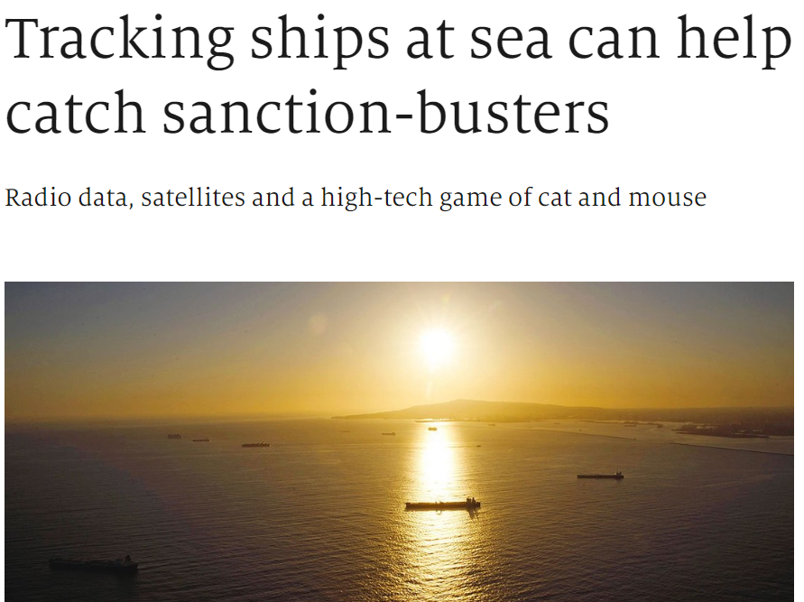
MARE Foresight Hub: Horizon Scanning

Slide 7
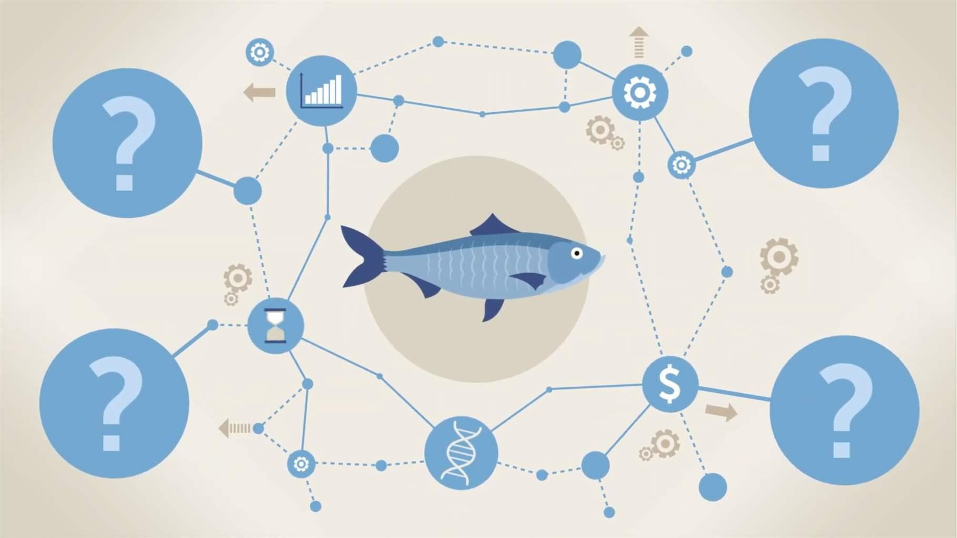
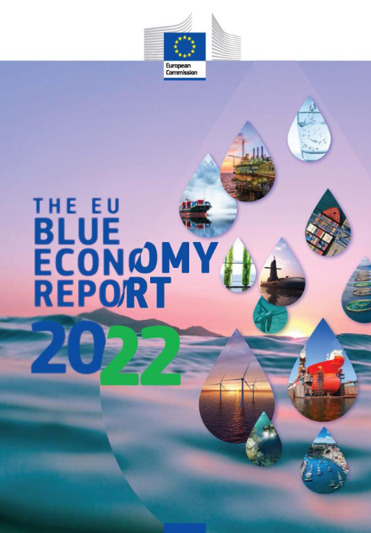
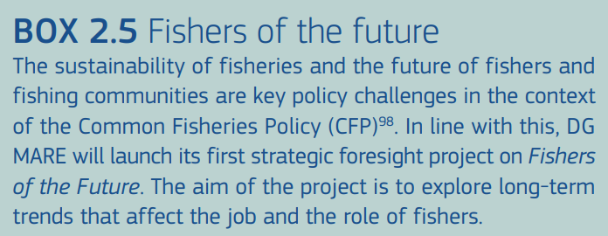
MARE Foresight Hub: Fishers of the Future

Slide 8
Useful links
EU Strategic Foresight, incl. Annual Reports, https://ec.europa.eu/info/strategy/strategic-planning/strategic-foresight_en.
Ministers of the Future, https://ec.europa.eu/info/files/ministers-future_en
Horizon Scanning, https://knowledge4policy.ec.europa.eu/foresight/topic/horizon-scanning_en
Megatrends Hub, https://knowledge4policy.ec.europa.eu/foresight/tool/megatrends-hub_en
European Strategy and Policy Analysis System (ESPAS), incl. Conference, 17/18 Nov. ‘22 on "Geopolitics is back: Charting a course for the EU in a world of shifts and shocks," https://espas.eu/conference2022.html

Slide 9
Thank you
© European Union 2020
Unless otherwise noted the reuse of this presentation is authorised under the CC BY 4.0 license. For any use or reproduction of elements that are not owned by the EU, permission may need to be sought directly from the respective right holders.
Notes:
Update/add/delete parts of the copy right notice where appropriate.
More information: https://myintracomm.ec.europa.eu/corp/intellectual-property/Documents/2019_Reuse-guidelines%28CC-BY%29.pdf

