Slide 1
ICES Advice for 2015 – Sea bass
Carmen Fernández, ICES ACOM vice-chair
For Inter AC Sea bass workshop (Paris, May 26, 2015)

Slide 2
Sea bass
Stock structure uncertain

Slide 3
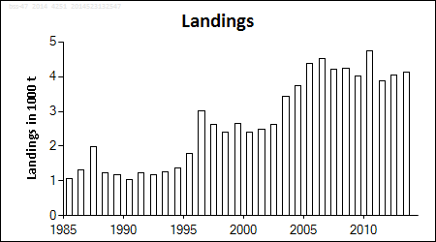
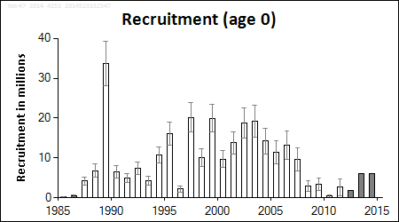
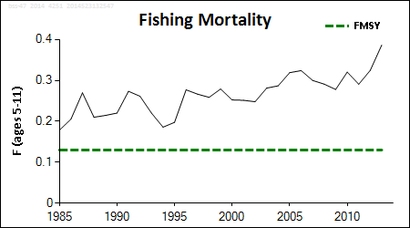
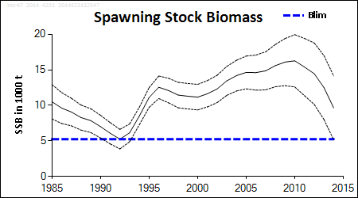
Sea bass in IVbc, VIIa and VIId-h
Advice for 2015, MSY: Total landings (commercial + recreational) < 1 155 t ; total catch can not be quantified
ICES has no basis for advising on the allocation of the advised landings to commercial and recreational fisheries. The commercial landings corresponding to the advice will depend on the recreational landings and vice versa.
A management plan urgently needed, to develop and implement measures to substantially reduce fishing mortality throughout the range of the stock.
Benchmark in 2014:
Model and input data improved
➔ Categ 1 and ref points
incorporates an F for recreational fisheries based on (few!) available estimates
* F increasing and > F_{MSY} proxy ; low recruitment and decreasing SSB
Notes:
The spawning biomass has been increasing since 1998 and is estimated to be record high in 2011.Fishing mortality has been decreasing in recent years, but is still above F_{MSY}. Recruitment fluctuations appear to be without substantial trend over the whole series. After several high recruitments in 2006 to 2008, the last two recruitments are estimated to be low.

Slide 4
Sea bass in IVbc, VIIa and VIId-h
Slow growth, late maturation, spawning aggregation, site fidelity
➔ increased vulnerability to overexploitation and localized depletion
Ocean warming in recent decades likely led to the more northerly distribution of sea bass
Above-average sea temperatures expected to be favourable to survival of young bass
Fisheries:
Targeted by pelagic pair trawlers on offshore spawning grounds (Dec to April)
Seasonal target or bycatch by large fleet of inshore vessels (various gears)
Moratorium of commercial sea bass fishing in VI and VII for Irish vessels since 1990
Discarding low, except for some small-mesh trawl fleets in inshore areas
Important species for recreational fishing (mostly angling)
Commercial landings 2013 ~ 4 100 t (discards not fully quantified ~ 5% in weight).
Recreational catch substantial, not fully quantified (surveys indicate annual removals ~ 1 500 t in recent years)

Slide 5
Sea bass in IVbc, VIIa and VIId-h
F (2014)= F(2011-13)= 0.33 (0.24 comm + 0.09 recreat); SSB(2015)= 7 600 t
Weights in tonnes F_{MSY}=0.13
Rationale | Landings comm+recreat (2015) | Basis | F Total | SSB (2016) | %SSB change
MSY approach | 1155 | F_{MSY} = 0.13 | 0.13 | 7241 | -5%
Zero catch | 0 | F_{total} = 0 | 0 | 8285 | +9%
Other options | 2685 | F₂₀₁₄ | 0.33 | 5869 | −23%
 | 2219 | 0.8 × F₂₀₁₄ | 0.27 | 6286 | -17%
 | 1720 | 0.6 × F₂₀₁₄ | 0.20 | 6733 | −11%
 | 1185 | 0.4 × F ₂₀₁₄ | 0.13 | 7214 | −5%
 | 613 | 0.2 × F_{. 2014} | 0.07 | 7730 | +2%
Management plan needed.
F should be reduced; stock likely to decline further due to recent low recruitment.
Improvement of fishery selection pattern needed (to allow more fish to spawn before capture) ➔ would require changes to gear design and spatial management
As there is no TAC for sea bass, there is potential for displacement of fishing effort from species with limiting quotas
* There are uncertainties in the assessment, but work is continuing

Slide 6
Sea bass in VIIIa,b (Bay of Biscay)
Advice for 2015, DLS:
New data available do not change the perception of the stock
➔ advice given for 2014 also applicable for 2015:
Commercial catch < 1 890 t ; discards considered negligible
Recreational catches can not be quantified
======================================================================
Fisheries: longlines (July-Oct);
pelagic trawl, nets, mixed bottom trawl (Nov-Apr) on spawning aggregations
Historical sampling of commercial catches of variable quality.
Recreational catches likely substantial in some areas:
time-series of recreational catches, releases, size/age composition needed
Time-series of relative abundance indices (pre-recruit and adults) needed.
ICES recommends that implementation of input controls should be promoted
Stock category: 5
In the absence of representative data for assessment: advice based on 20% precautionary reduction over recent (2009-2011) average commercial landings
Notes:
The spawning biomass has been increasing since 1998 and is estimated to be record high in 2011.Fishing mortality has been decreasing in recent years, but is still above F_{MSY}. Recruitment fluctuations appear to be without substantial trend over the whole series. After several high recruitments in 2006 to 2008, the last two recruitments are estimated to be low.

Slide 7
Sea bass in VIIIc & IXa (Atlantic Iberian waters)
Advice for 2015, DLS:
New data available do not change the perception of the stock
➔ advice given for 2014 also applicable for 2015:
Commercial catch < 598 t ; discards considered negligible
Recreational catches can no be quantified
======================================================================
Fisheries: mostly coastal artisanal (various gears)
Historical sampling of commercial catches of variable quality.
Recreational catches likely substantial in some areas:
time-series of recreational catches, releases, size/age composition needed
Time-series of relative abundance indices (pre-recruit and adults) needed.
ICES recommends that implementation of input controls should be promoted
Stock category: 5
In the absence of representative data for assessment: advice based on 20% precautionary reduction over recent (2009-2011) average commercial landings
Notes:
The spawning biomass has been increasing since 1998 and is estimated to be record high in 2011.Fishing mortality has been decreasing in recent years, but is still above F_{MSY}. Recruitment fluctuations appear to be without substantial trend over the whole series. After several high recruitments in 2006 to 2008, the last two recruitments are estimated to be low.

Slide 8
Sea bass in VIa, VIIb and VIIj (West of Scotland and Ireland)
Advice for 2015, DLS:
Landings data were revised downwards; no change to stock perception, but reapplication of previous year’s method with the revised data revised the advice to
Commercial landings < 5 t ; total catch can not be quantified
Not clear whether this should constitute a separate management unit
ICES does not necessarily advocate the introduction of a TAC for sea bass in this area
======================================================================
Only official landings available;
no information on discards
recreational catch unknown (important recreational species)
Moratorium on commercial fishing for Irish vessels in VI and VII; any catches by Irish commercial vessels are discarded. Commercial landings mostly from French vessels.
ICES recommends that implementation of input controls should be promoted
Stock category: 6
In the absence of representative data for assessment: advice based on 20% precautionary reduction over recent (2009-2011) average commercial landings
Notes:
The spawning biomass has been increasing since 1998 and is estimated to be record high in 2011.Fishing mortality has been decreasing in recent years, but is still above F_{MSY}. Recruitment fluctuations appear to be without substantial trend over the whole series. After several high recruitments in 2006 to 2008, the last two recruitments are estimated to be low.

Slide 9
All advice available online at:
http://www.ices.dk
Click on
Follow Advisory process ➔ Latest advice
For advice release dates, follow link:
Follow Advisory process ➔ Advice requests and advice release dates
Advice online
Notes:
For the stocks in the Celtic Sea and West of Scotland ecoregion there is any MP fulfilling the conditions referred to (evaluated by ICES to be PA & recognized ….). The basis for ICES advice for 2012 is the ICES MSY framework.

Slide 10
Thank you!
Comments/Questions ?

